Slide 1
412 Week 4 Progress
by: Yousef Alkhelaifi, Calvin Xaybanha, Yikun Wang, Yudi Bao, Brandon Garcia

Slide 2
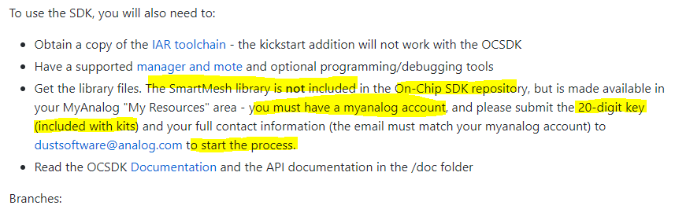
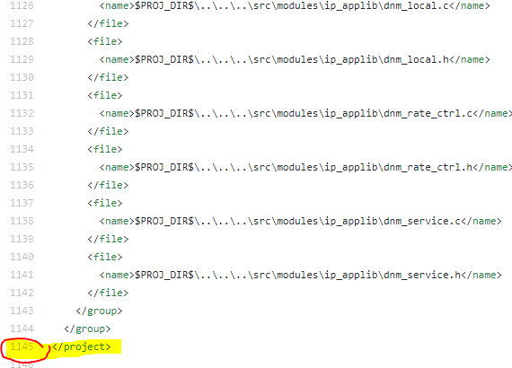
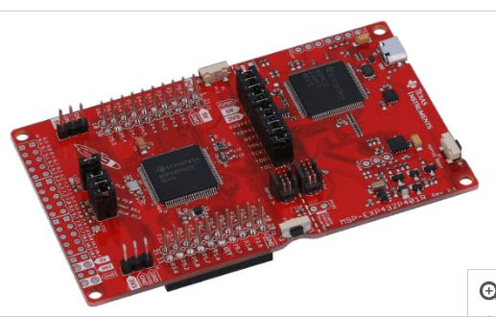
Yousef Al-Khelaifi
Completed
Smartmesh IP BOM research to find get the basic set of components needed for cheapest price
Microcontroller research [ Texas instruments - MSP432P401]
Development board - $19.99
Roughly 100 pins and great low power performance (80uA/Mhz)
TI supports debugging and programming only through Code composer studio
Might be too complex, if we are willing to invest the time of learning this complex chip, why not invest the time to learning using LTP5900 chip as primary microcontroller.
Finalized initial peak-power consumption table
Found some worrying thing on dust cloud

Slide 3
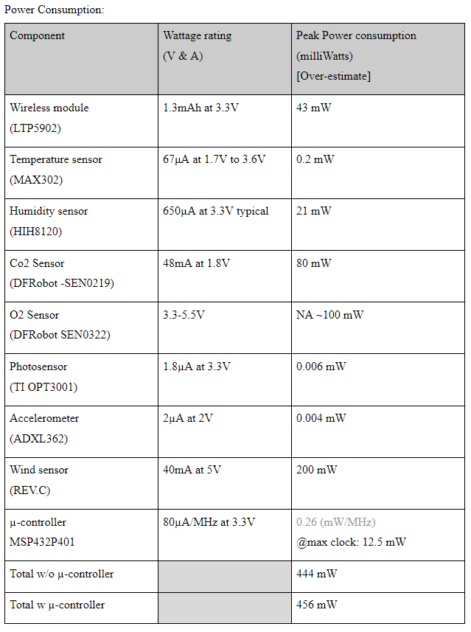
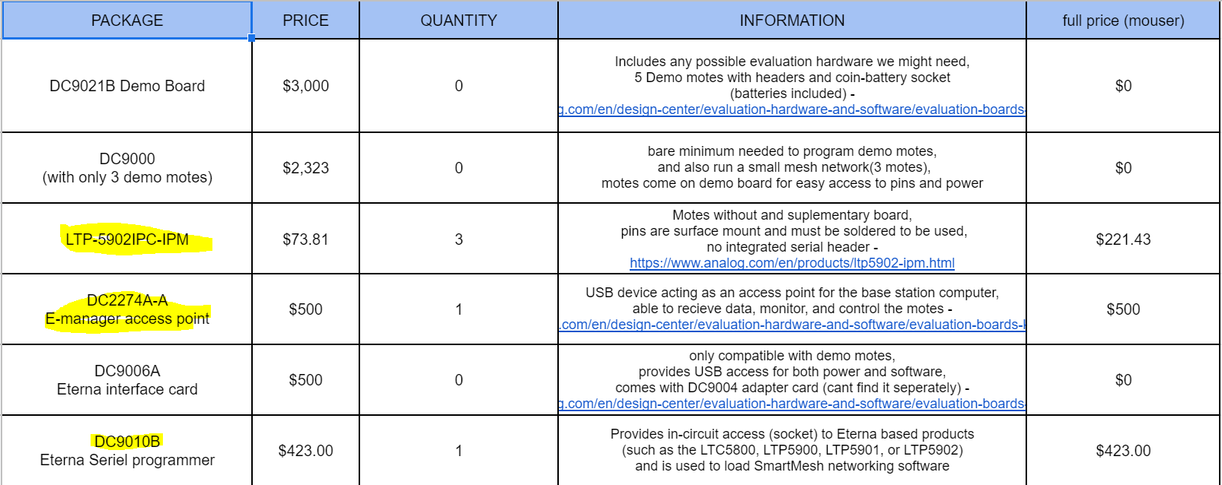
Extra stuff
In Progress:
Hands on testing with smart mesh hardware
Researching SPI and I2C communication

Slide 4
Calvin Xaybanha
Completed:
Rough Project Schedule outlined
Inprogress:
Review and revise Project Design Specifications

Slide 5
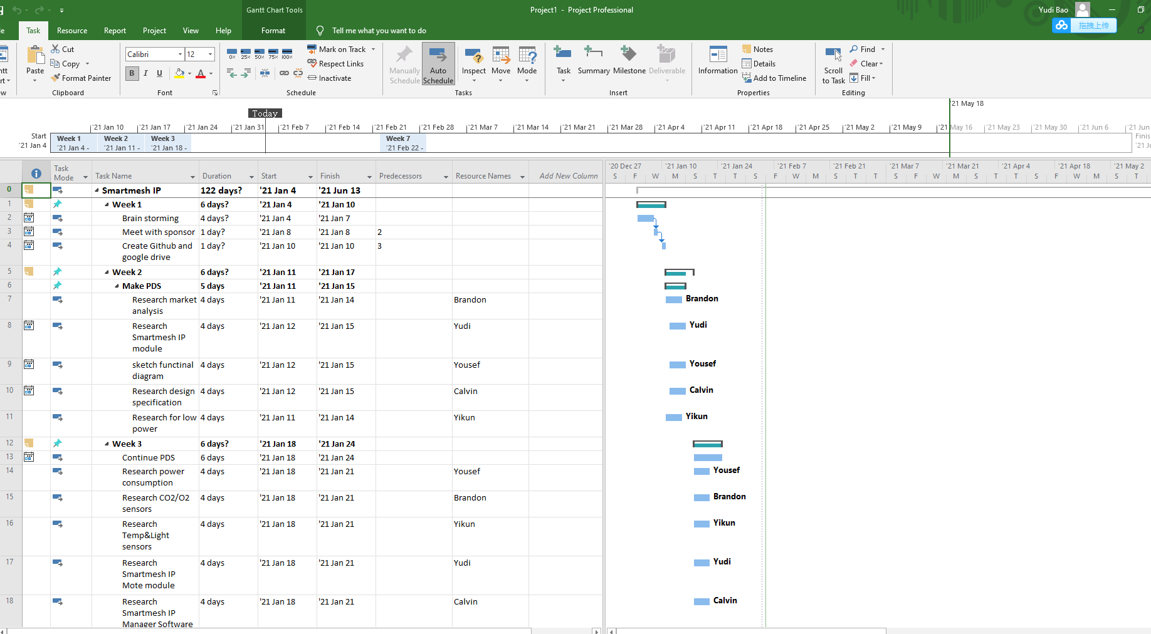
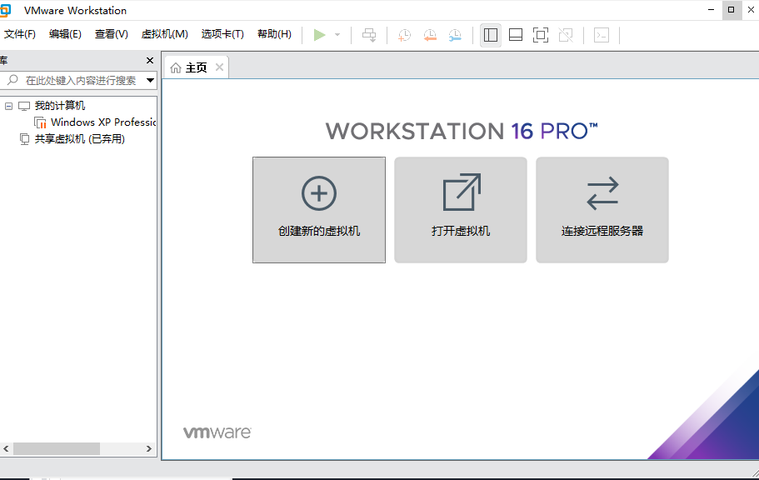
Yudi Bao
Completed:
First version of Product Schedule
Configure virtual machine for Emanager running
In progress:
Continue to configure Smartmesh SDK part to
Win XP system by following the document of
SmartMesh WirelessHART Easy Start Guide

Slide 6
The 1st project schedule:
1.Add missions from Week 1 to Week 22 to build frame of our work
2.Try to give all groups an even distribution of tasks

Slide 7
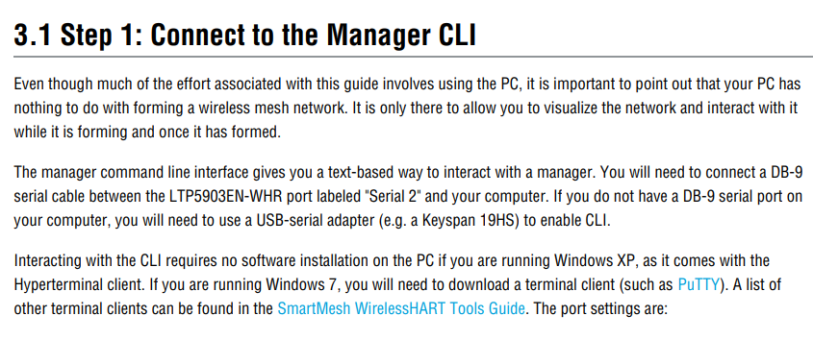
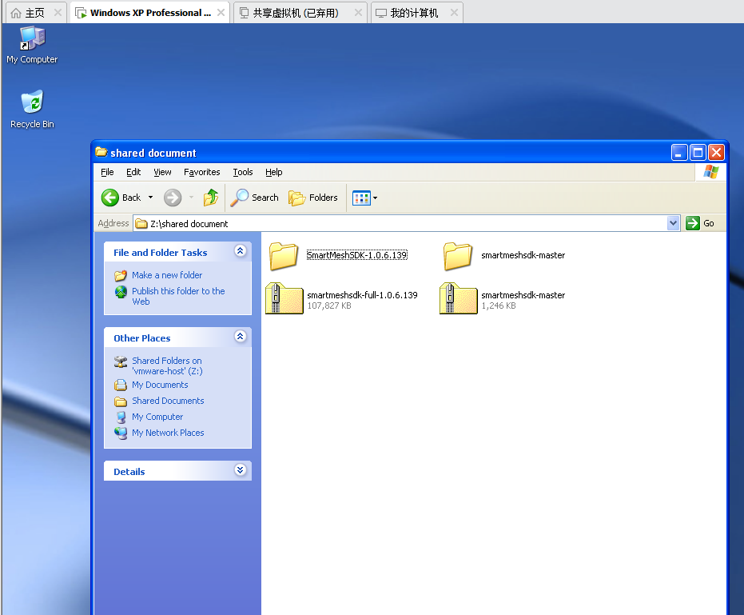
VMware Workstation Pro 16
For Win XP operating system
According to document, Smartmesh SDK can match with Win XP, that’s why we need virtual machine(VM) to meet the requirement of software running.
1.find resource of .iso document 2. Search for activate code
3.upload Smartmesh SDK file to VM

Slide 8
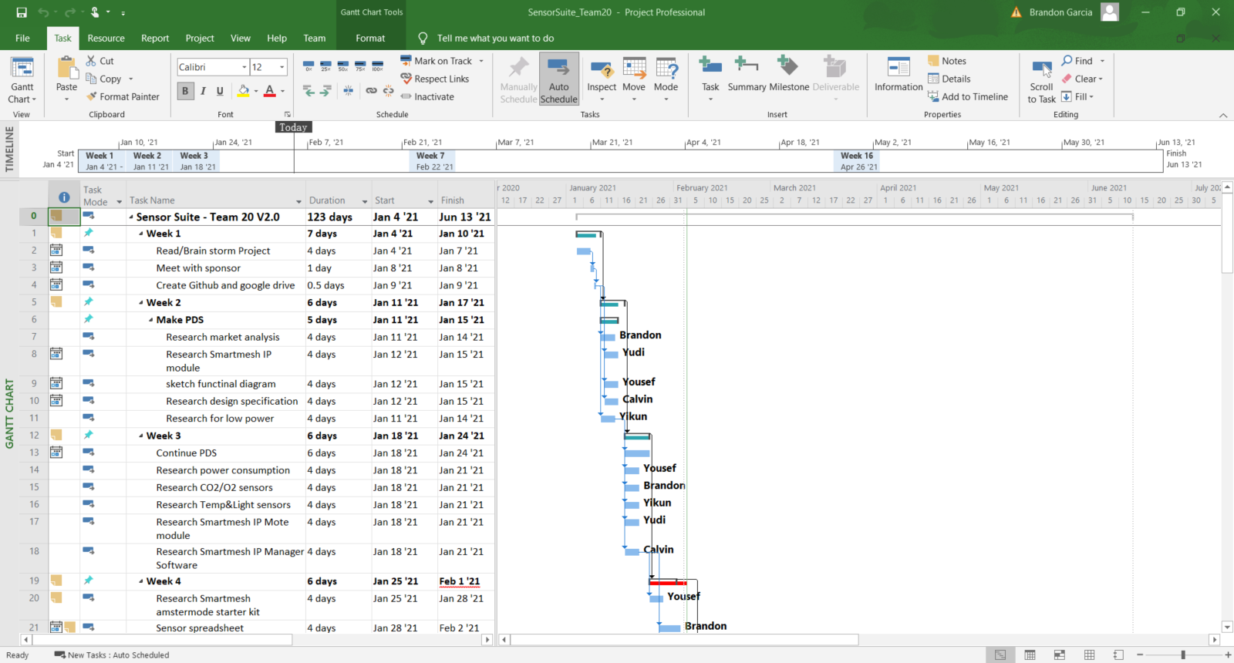
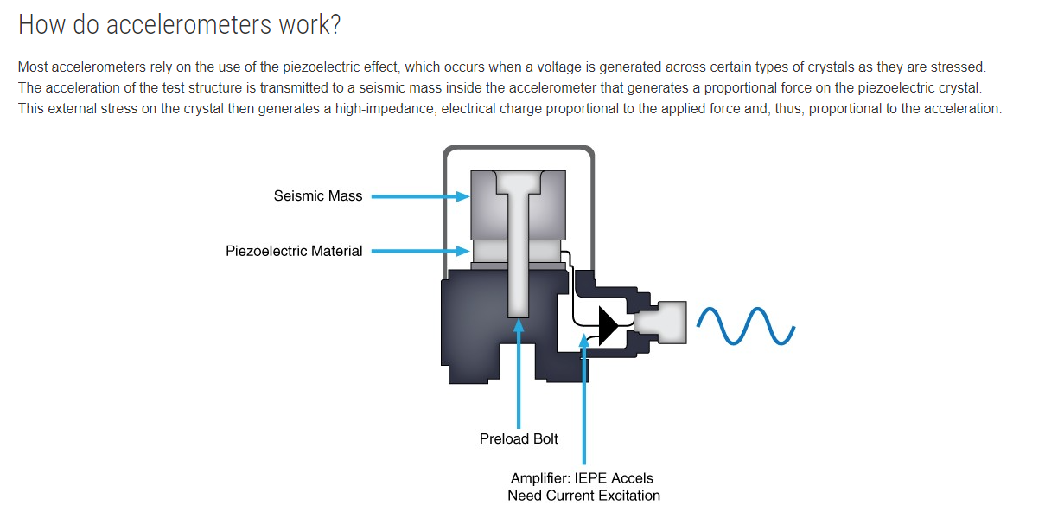
Brandon Garcia
Completed:
Final Draft of Project schedule
Helped with Vibration Sensor search
Finalize BOM for sensors
In Progress:
Need PDS approval
Github/Documentation Upload

Slide 9
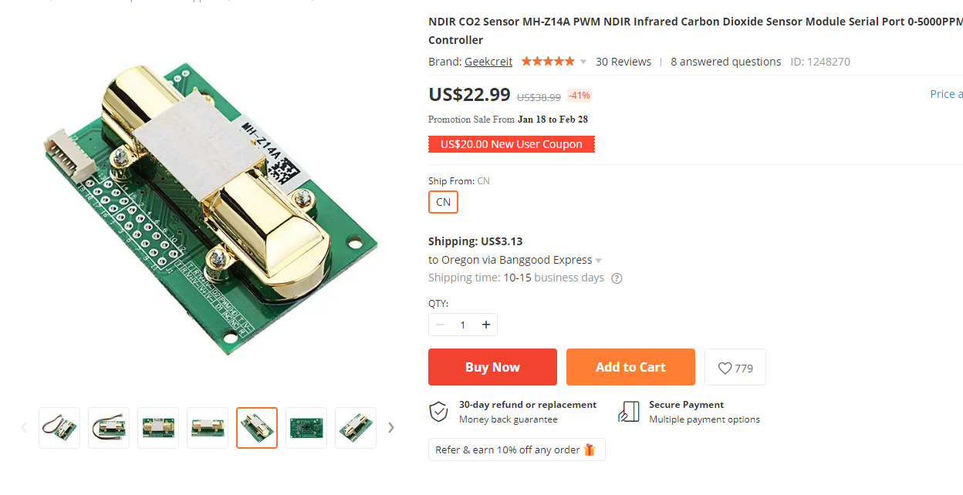
CN CO2 Sensor- DFR Rebrand!

Slide 10
Yikun Wang
Completed:
Research on Vibration Sensor
Inprogress:
Research on water contact sensor because of the supply power requirement
Research on the code of our sensor_finding some similar examples

Slide 11
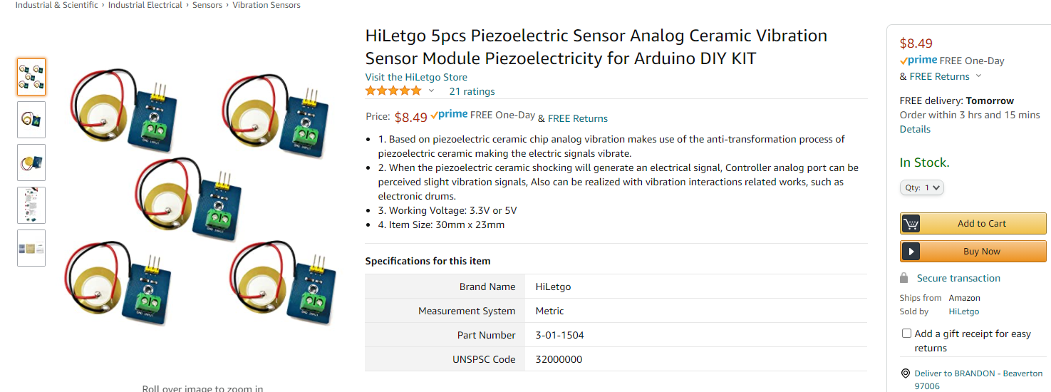
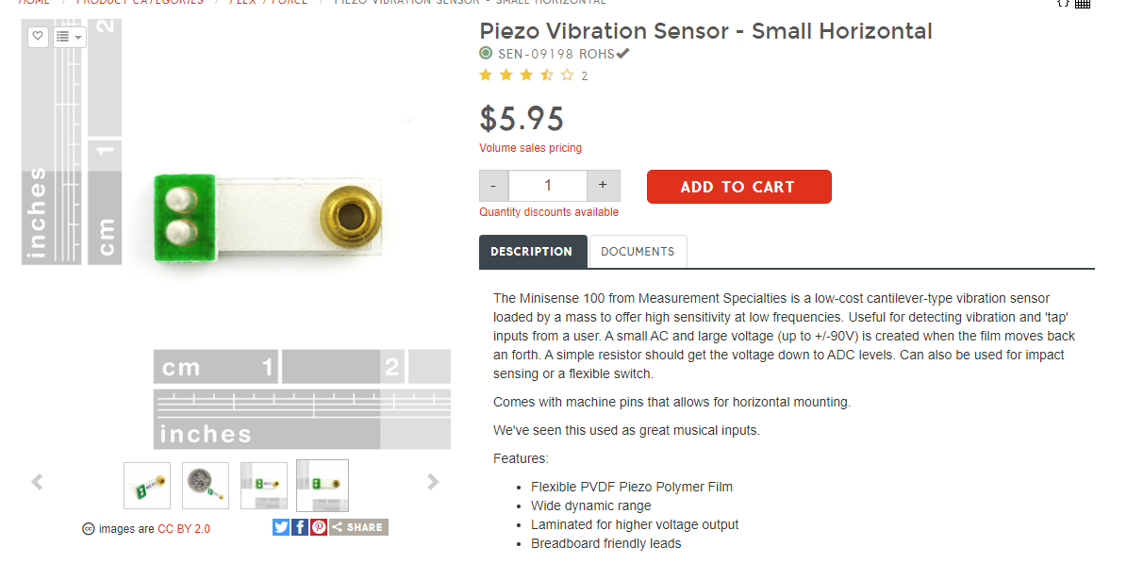
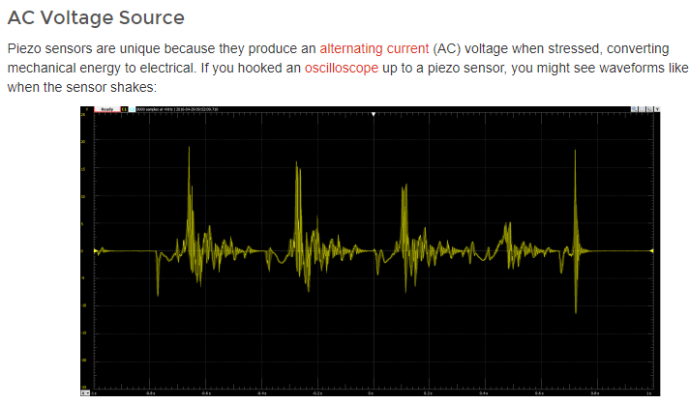
Piezoelectric Sensor(Vibration)

